Slide 1

Mastering Python Functions Empower Your Python Skills with 20 Functions
Photo by Pexels

Slide 2
01
Create a Function
Table of Contents
02
Add Two Numbers
03
Subtract Two Numbers
04
Multiply Two Numbers
05
Divide Two Numbers
06
Calculate Factorial
07
Fibonacci Sequence
08
Check Prime
09
Find GCD
10
Find LCM
11
Reverse String
12
Count Vowels

Slide 3
13
Check Palindrome
Table of Contents
14
Convert to Uppercase
15
Remove Duplicates
16
Find Length
17
Find Max
18
Find Min
19
List Comprehension
20
Find Common Elements

Slide 4

1
Create a Function
Hello, World!
Write a function that returns 'Hello, World!' Python function to display 'Hello, World!' Simple function to greet the world Example: def hello_world(): return 'Hello, World!'
Photo by Pexels

Slide 5

2
Add Two Numbers
Sum Function
Function to add two numbers in Python Adds two input numbers and returns the result Basic addition function Example: def add(a, b): return a+b
Photo by Pexels

Slide 6
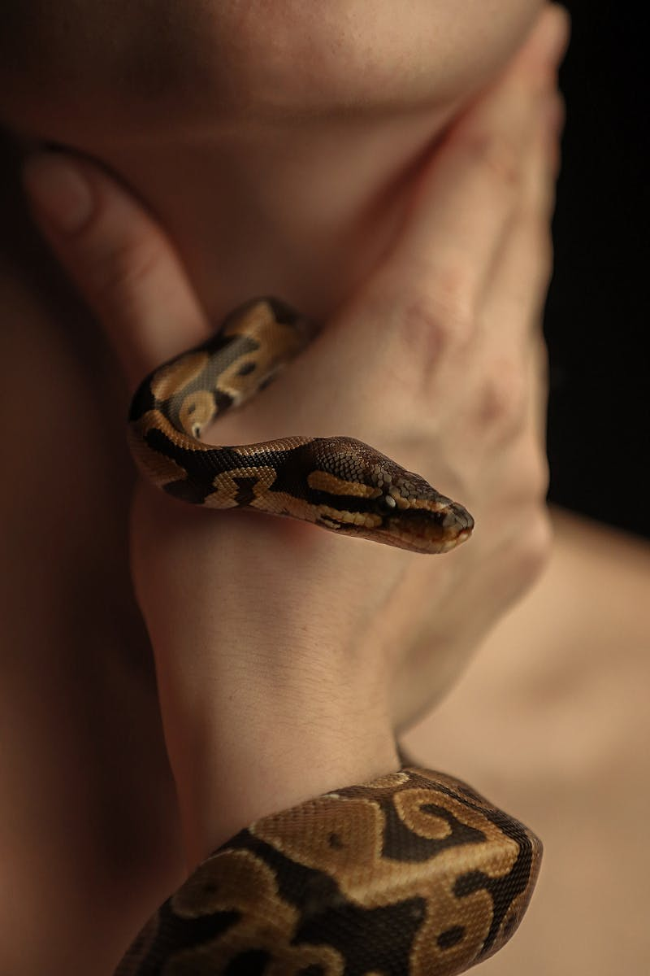
3
Subtract Two Numbers
Subtraction Function
Write a function to subtract two numbers Subtracts second number from the first Basic subtraction function in Python Example: def subtract(a, b): return a-b
Photo by Pexels

Slide 7
4
Multiply Two Numbers
Multiplication Function
Function to multiply two numbers in Python Multiplies two given numbers Basic multiplication function Example: def multiply(a, b): return a*b
Photo by Pexels

Slide 8

5
Divide Two Numbers
Division Function
Python function to divide two numbers Divides the first number by the second Basic division function Example: def divide(a, b): return a/b
Photo by Pexels

Slide 9

6
Calculate Factorial
Factorial Calculation
Function to calculate the factorial of a number Recursively calculates n! Factorial function in Python Example: def factorial(n): return n*factorial(n-1)
Photo by Pexels

Slide 10
7
Fibonacci Sequence
Generate Fibonacci
Function to generate the Fibonacci sequence up to n terms Generates Fibonacci numbers up to n Fibonacci sequence generator Example: def fibonacci(n): return fibonacci sequence
Photo by Pexels

Slide 11

8
Check Prime
Prime Number Checker
Function to check if a number is prime in Python Evaluates whether a number is prime or not Prime number checking function Example: def is_prime(n): return True if prime
Photo by Pexels

Slide 12
9
Find GCD
Greatest Common Divisor
Function to find the greatest common divisor of two numbers Calculates the GCD using Euclidean Algorithm GCD finding function Example: def gcd(a, b): return gcd of a and b
Photo by Pexels

Slide 13
10
Find LCM
Least Common Multiple
Python function to find the least common multiple of two numbers Uses GCD to compute LCM LCM computation function Example: def lcm(a, b): return LCM of a and b
Photo by Pexels

Slide 14
11
Reverse String
String Reversal
Function to reverse a string in Python Reverses the input string String reversal function Example: def reverse_string(s): return reversed string
Photo by Pexels

Slide 15

12
Count Vowels
Vowel Counter
Function to count the number of vowels in a string Counts and returns the total vowels in the input Vowel counting function Example: def count_vowels(s): return number of vowels
Photo by Pexels

Slide 16

13
Check Palindrome
Palindrome Checker
Function to check if a string is a palindrome in Python Checks if the input string is a palindrome Palindrome checking function Example: def is_palindrome(s): return True if palindrome
Photo by Pexels

Slide 17
14
Convert to Uppercase
Uppercase Converter
Function to convert a string to uppercase in Python Converts the input string to uppercase Uppercase conversion function Example: def to_uppercase(s): return string in uppercase
Photo by Pexels

Slide 18
15
Remove Duplicates
Duplicate Remover
Function to remove duplicates from a list in Python Eliminates duplicate elements in the list Duplicates removal function Example: def remove_duplicates(lst): return list without duplicates
Photo by Pexels

Slide 19

16
Find Length
List Length Finder
Function to find the length of a list in Python Returns the number of elements in the list List length determination function Example: def find_length(lst): return length of the list
Photo by Pexels

Slide 20

17
Find Max
Maximum Element Finder
Function to find the maximum element in a list in Python Identifies and returns the largest element Max element finding function Example: def find_max(lst): return the maximum value in the list
Photo by Pexels

Slide 21

18
Find Min
Minimum Element Finder
Function to find the minimum element in a list in Python Detects and returns the smallest element Min element finding function Example: def find_min(lst): return the minimum value in the list
Photo by Pexels

Slide 22

19
List Comprehension
Squares List Generator
Function to return a list of squares of elements in a list Generates a list containing squares of input elements Squares list generation function Example: def list_comprehension(lst): return list of squared elements
Photo by Pexels

Slide 23
20
Find Common Elements
Common Elements Finder
Function to find common elements in multiple lists in Python Identifies elements present in all input lists Common elements identification function Example: def common_elements(*lists): return common elements
Photo by Pexels

